Slide 1
Wondering in the woods Developed by Keerthi koushik devulapally Nikhil reddy jitta Ranjith reddy pingli Neelima vuyyuru Paladi Mahesh Gowtham

Slide 2
Purpose
The results will be noted after the explanation of case study.
Agile methods are used for maintaining a guideline.
Due to the change in chapter the documentation also changes.
System Architecture should be properly classified ay first.
Every time the new data is available then the design model is explained. There should be no subsystem attached to it.
Design team is needed so that upgradation data can be sorted.
A proper blueprint should be depicted for completing the work.
A Feedback is always required for improvement.

Slide 3
Wandering in woods
Wandering in woods is a game .It is a simple game used by the school students.
This game is only applicable for the students of grade three to grade five students due to less less data .The advantage of this game is the it helps the students to make decision.Here less data is given.
From this game the students of grade six to grde eight will get the updated version. As these students can work on the database.charts and many other things which help them to make decision.

Slide 4
Procedure
Procedure helps the business to grow more and more .
The game development is necessary .
All the agile procedure are maintained.
Modularization of project happens as a result the costs alops goes up.
The demands which were put in front were all be solved.

Slide 5
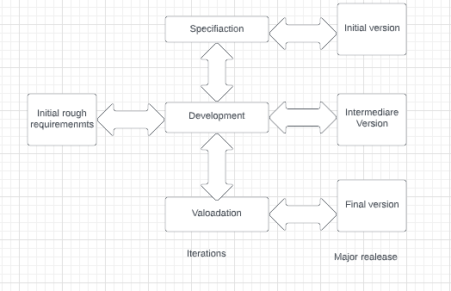
Procedure - Sketch presentation

Slide 6
Use
Use case means that some specific task is assigned to system by the user.
Explanation how to handle the system. step-1)Start game step-2) Play Game Step-3)Choose stage Step-4) View stage Step-5) Replay Game Step-6) EXit game Step-7) Diagonal Move Step-8)e Random Move Step-9) Change Grid Step-10)Play challenges Step-11) Verify the wandering methods .
Selection of destination when the game starts .

Slide 7

Use-Case Diagram of UML
Computer Simulation System
Simplified Visualization
1-2 Students
Moderate Visualization
3-5 Students
Complex Visualization
6-8 Students

Slide 8
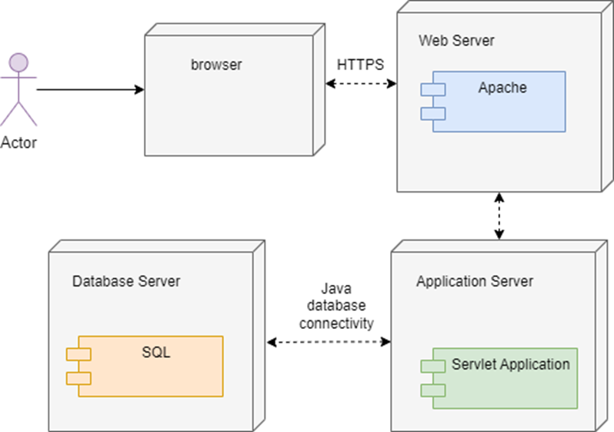
Deployment Diagram of UML

Slide 9
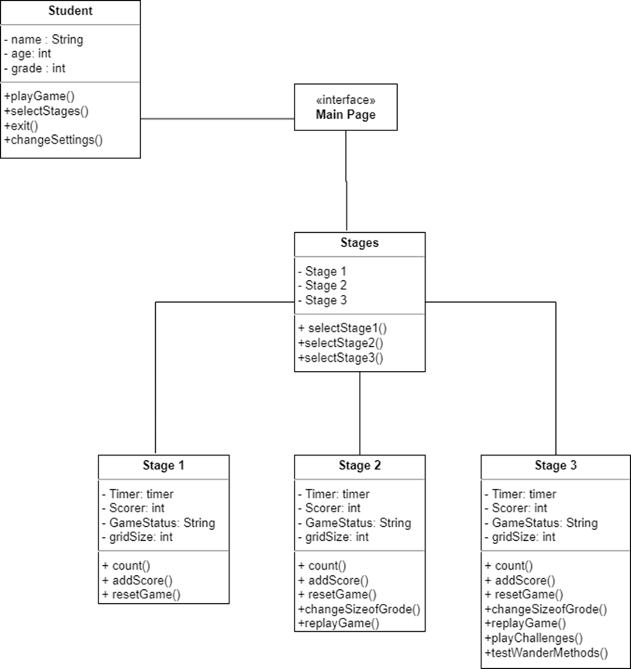
Class Diagram of UML

Slide 10
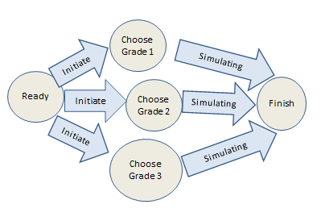
State Diagram of UML

Slide 11
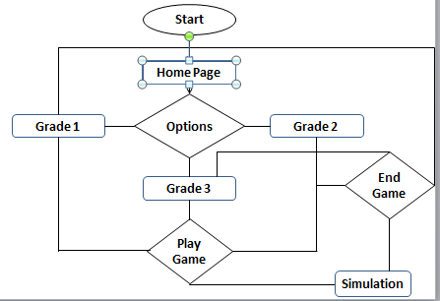
Activity Diagram of UML

Slide 12
Journey map of customer
The map mentions how the brand works .
When the customer is not happy then it can give its prediction.
The product should be modified by seeing the customers demand.
The map depicts the whole procedure process of the products.
The team who makes the route map knows the demand of the customer.

Slide 13
Conclusion
The system helps to analyse a student by playing.
Student should be interested in game.
The game help the student ro widen his thought.
When a new game starts then the student may face new challenges related to game.

